Slide 1
Real Time Indian Sign Language Detection
Directed by : Dr. Suneet Kumar Gupta
Team Members: Moksh Malik ( E22MCAG0020 )
Varnika Vyas ( E22MCAG0015 )
Ananya Gandhi ( E22MCAG0038 )

Slide 2
Contents
What is Indian Sign Language
What is YOLOv5?
Creating a Dataset
Annotating
What a label looks like
Data preprocessing and Augmentation
Training
Evaluating a Model
Deploying the Model
Video of the Project

Slide 3

What is Indian Sign Language (ISL)?
ISL is a visual language used by deaf and hard-of-hearing communities in India.
It involves the use of gestures and facial expressions to convey meaning.
Has 26 letters, just like the English alphabet.

Slide 4

What is YOLOv5 ?
YOLOv5 stands for You Only Look Once version 5.
Uses deep learning to detect objects in real-time.
A pre-trained architecture trained on the MS-COCO dataset consisting of 80 different classes of general objects.
Comes in different variants depending on training parameters.
Used for Real-time Indian Sign Language Detection

Slide 5
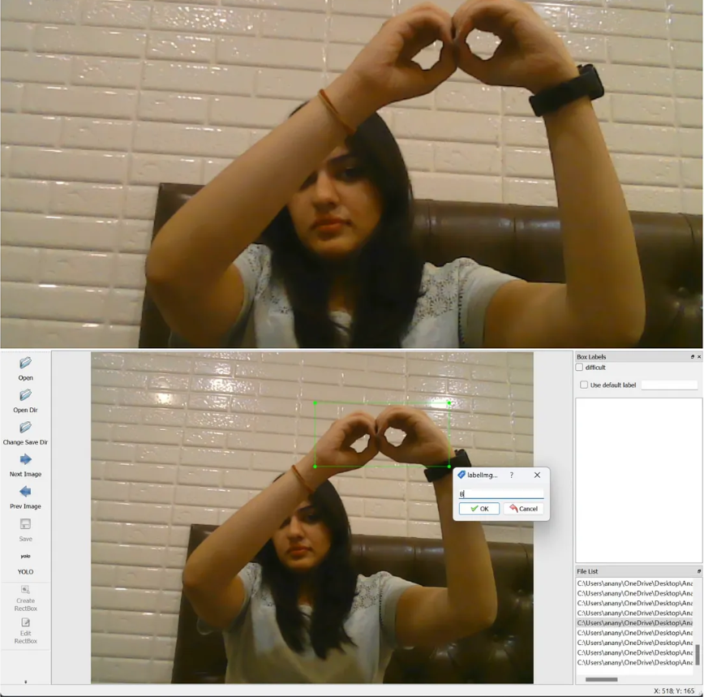
Creating a Dataset
Used OpenCV library in Python to capture images (33 per class) in .jpg format for each alphabet of ISL.
Create a final dataset of approximately 100 images per class.
Used labelImg software to label (annotate) the captured images with bounding boxes.
Integrated the dataset with publicly available dataset

Slide 6
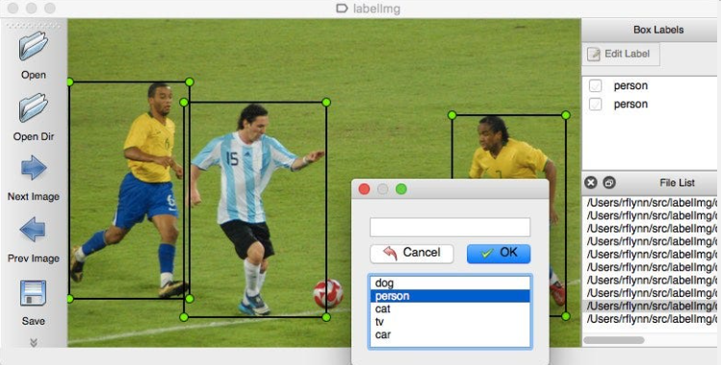
Annotating
Used labelImg software for labelling which is an open-source software.
Bounding boxes around the object are created with the name of its class.
Some images were not labelled so the model can recognise when not to recognise the object.

Slide 7
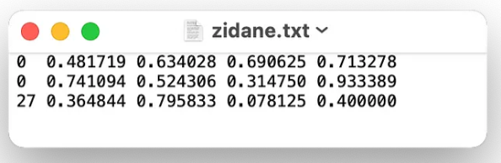
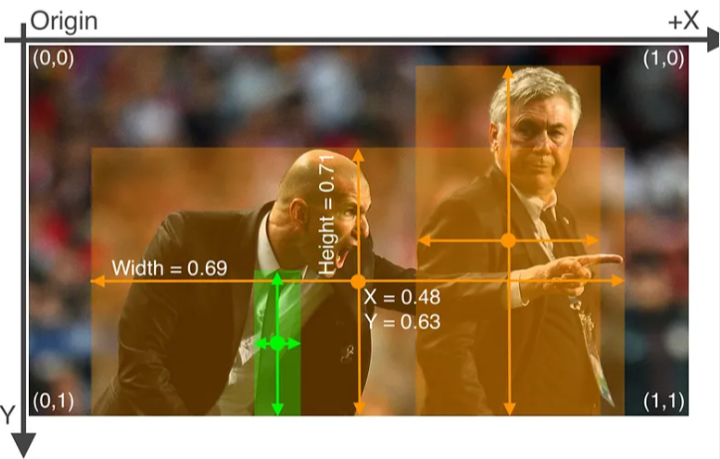
What a label looks like?
A label is a text file that includes the class, x and y coordinates, width, and height of the bounding box in normalized XYWH format (0-1).
The text file (labels) for the corresponding image

Slide 8
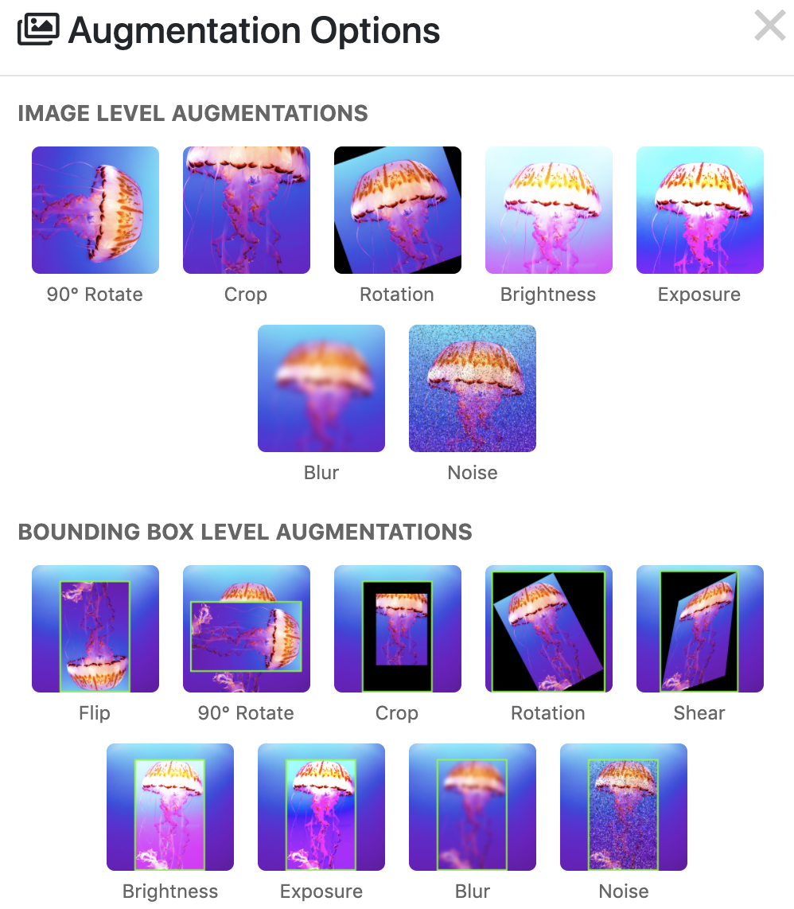
Data Preprocessing and Augmentation
Preprocessing techniques such as Auto-Orient and Resize were used.
Augmentations, for example, Flip, Rotation, Blur were used.
Data size was increased by using such methods.
Overfitting was avoided after augmentation of the dataset

Slide 9
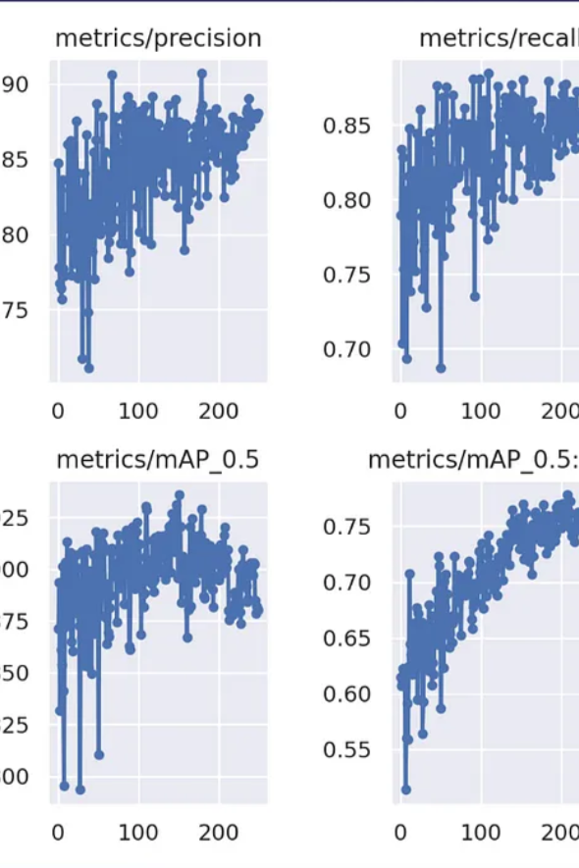
Training
Custom YAML file for 26 classes was created.
YOLOv5s version was used because of faster real-time inference and smaller size.
The model was trained with a batch size of 128 for 250 epochs using default weights.
Achieved mAP of more than 95% in it’s best run

Slide 10
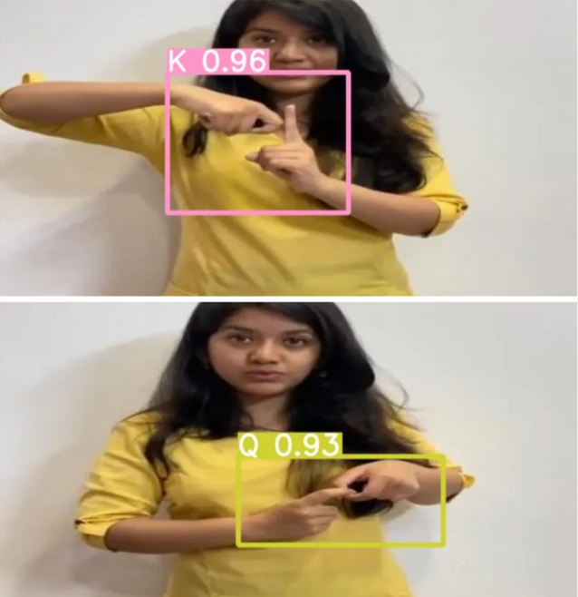
Evaluating the model
Inference was run on the test images to check the accuracy of the trained model.
The weights (best.pt) were uploaded to Roboflow platform for the deployment part.
The model showed very high accuracy on the testing dataset (more than 90%)
Output of inference

Slide 11
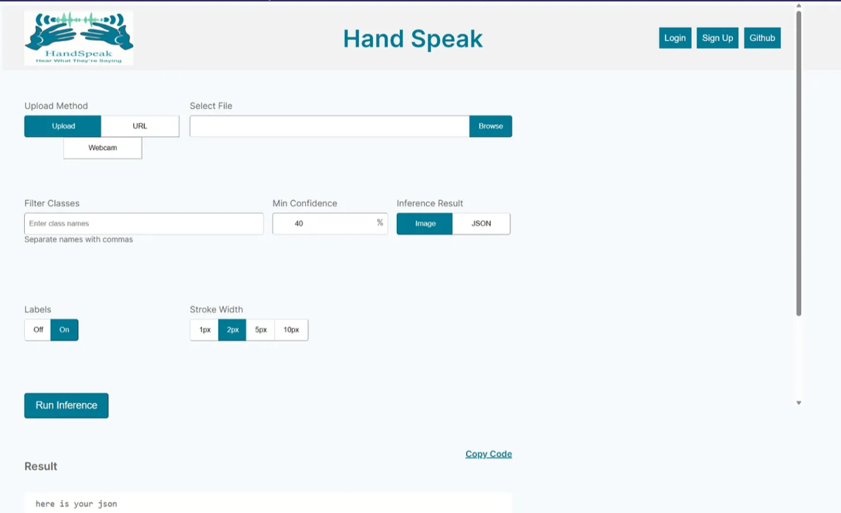
Deploying the model
The trained model was hosted at the Roboflow server.
Deployment was performed as a website.
The website provides option for inference on images in your local device or hosted elsewhere through URL.
Also provides the option for real-time inference through your webcam.

Slide 12

Video of the project

Slide 13
Thank you for your time 😊

